Slide 1
Solar Record Management System – Load, Process, Visualize and Save
Student Name : Mohammad Sarker
Author : 10152420
Module title : Problem Solving Through Programming
Module Code : QHO426
Tutor’s name : Yaroslav Basha

Slide 2
Introduction
The task here is to create a software application that can be used to display and process solar system data. The data will be present in a CSV file format and the data will cover non-planets and planets present in the solar system.

Slide 3
Methodology
There are a series of steps required to be taken to form the application. The primary step is going to be to show the welcome message stating, ‘Solar Record Management System’. The menu containing the options: Load data, process data, visualize data, save data and exit will be displayed. These steps are then enforced as per user requirements.

Slide 4
Results and Discussion
There are four part in this systems. Which are as follows:
Data loaded from CSV file
Data process
Data visualize and animated
Data Export as JSON format

Slide 5



Visual – It consist of 4 task to display plots pie chart and bar chart as well as animated and data come from CSV file.
Main – It consist of 10 task where contains the main logic for this solar system applications such as calling various functions from tui and visual, loading data from CSV file into a list and then finally all data export to json file format via OOP abstract method.
Tui – It consist of 16 task to create welcome message , various text-based menu options, user input and more.
There are mainly three files to work with – ‘tui.py’, ‘visual.py’ and ‘main.py’ which consist of 30 tasks are as follow:

Slide 6
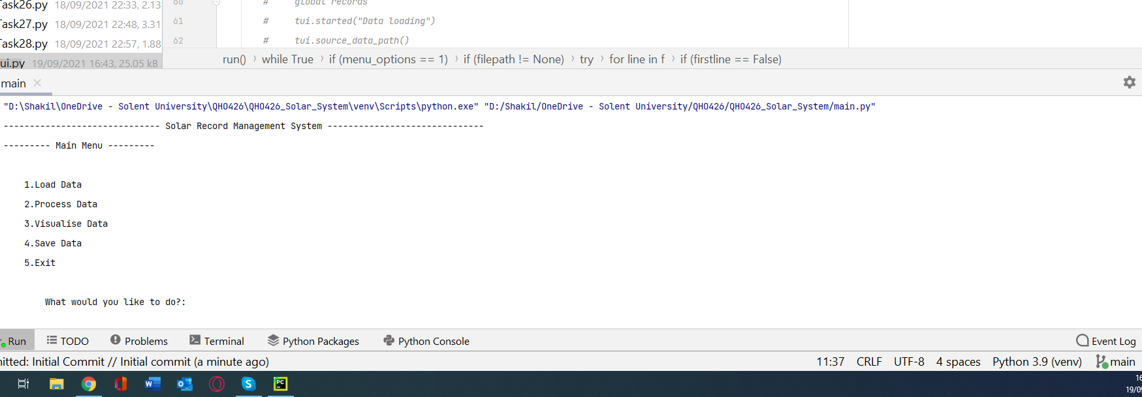
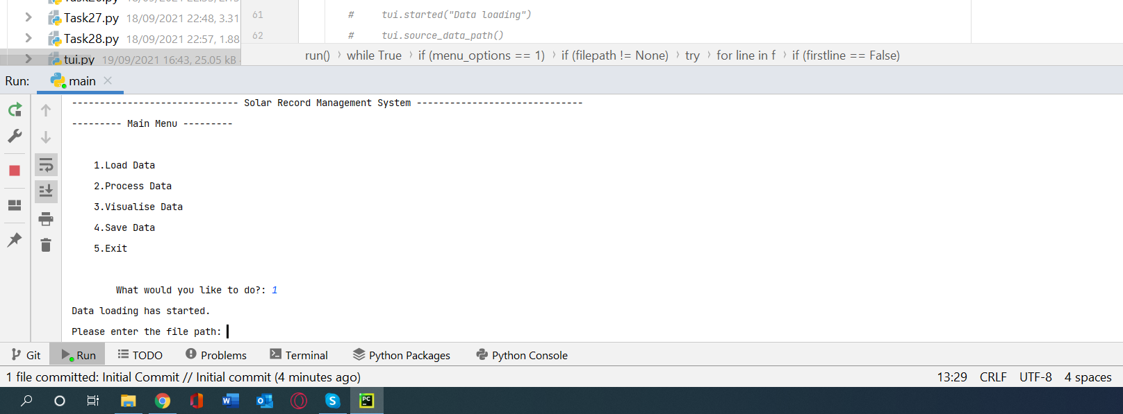
Main Screen
Ask user to input 1 all time when runs first time to load data
Please enter the file path and name with CSV extension

Slide 7

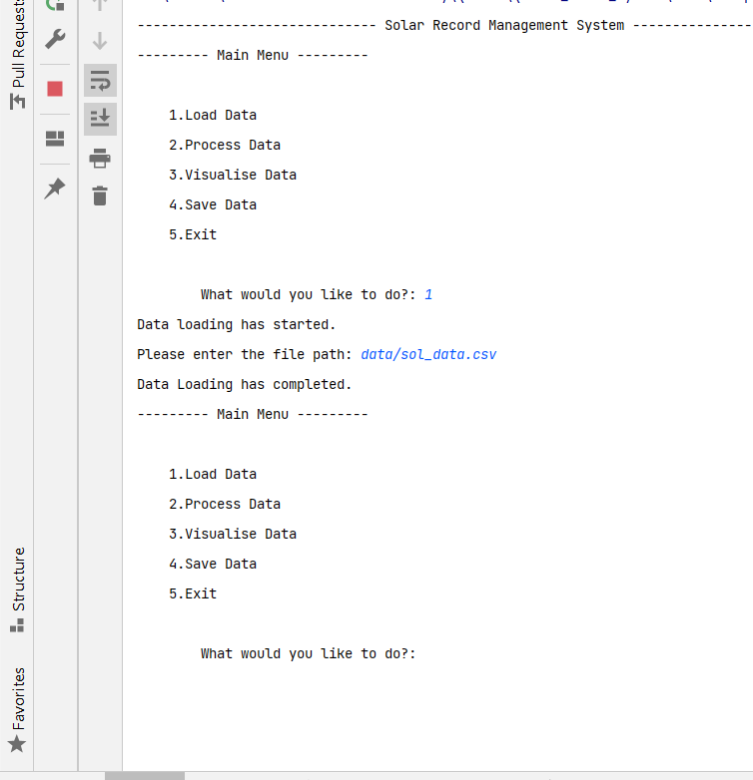
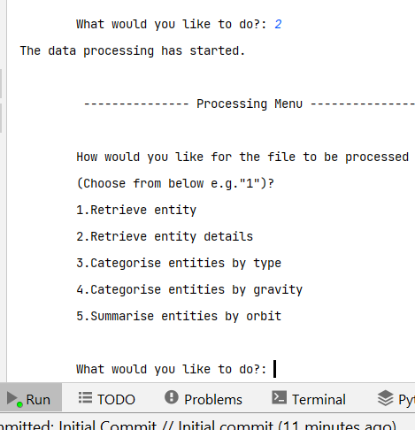
Input 2 for Process Data

Slide 8
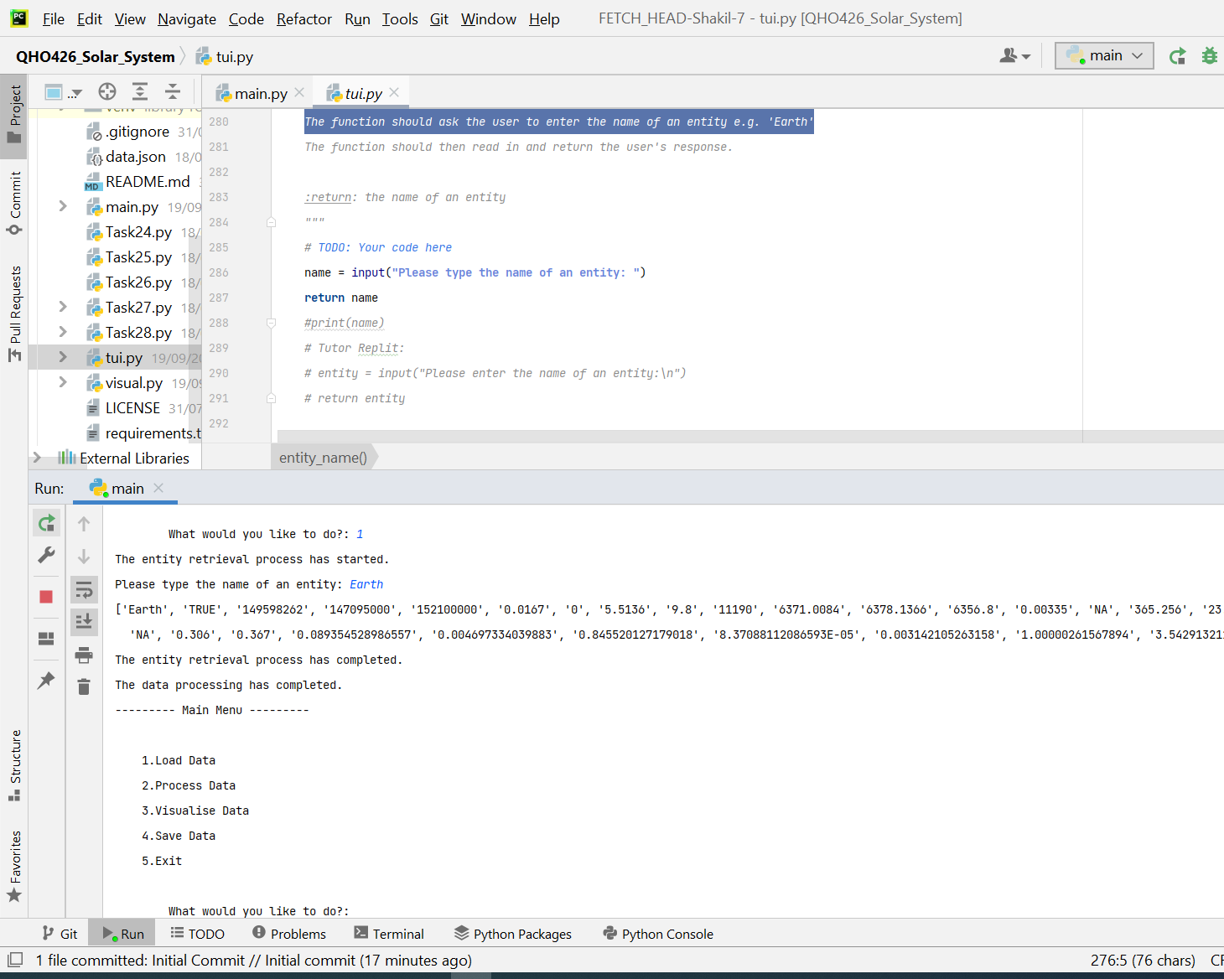
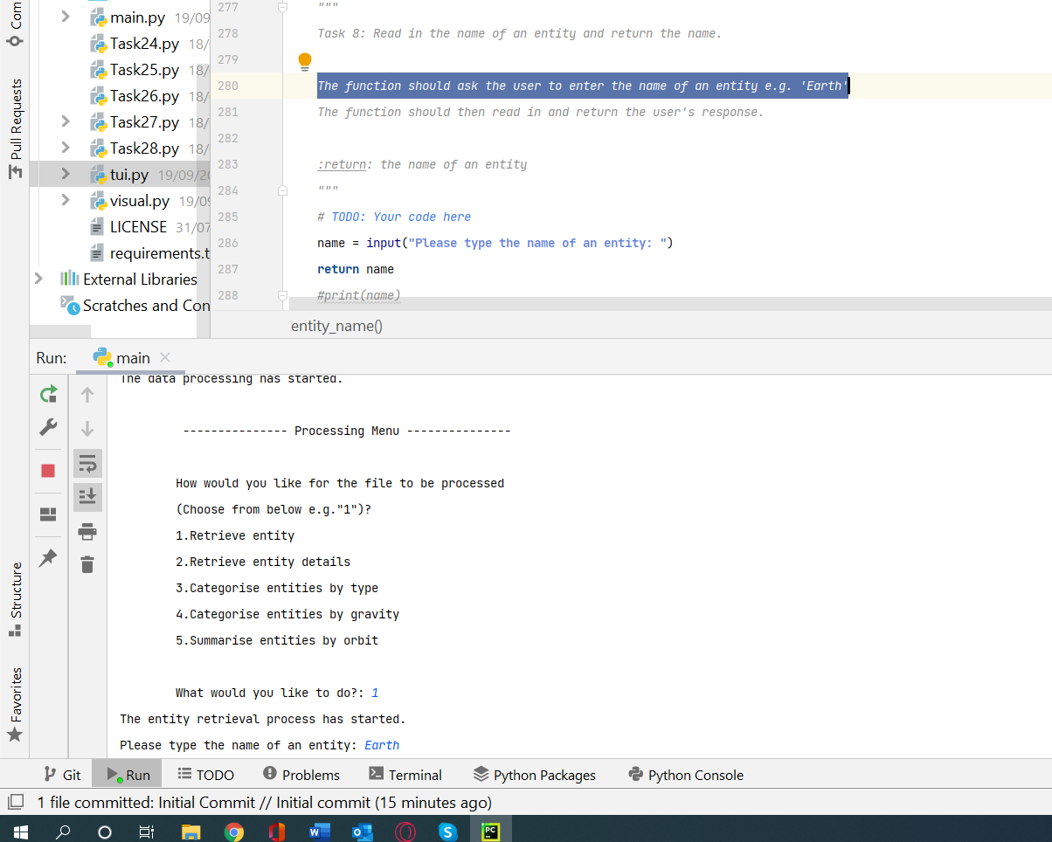

Slide 9
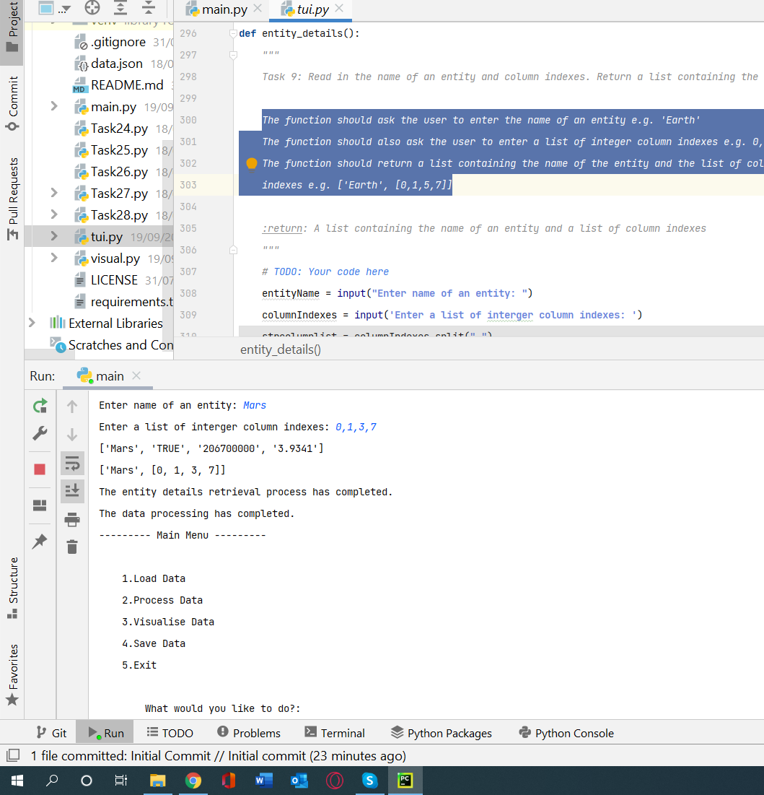
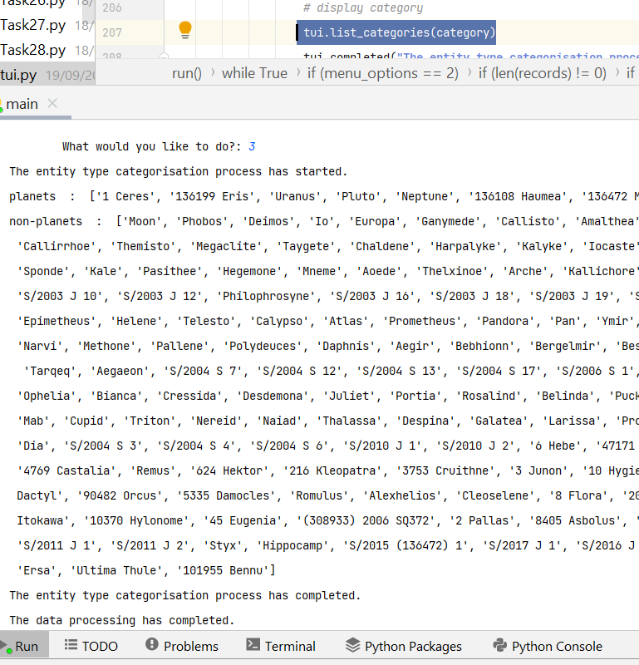
The entity type categorisation process has completed.
Input 2 to Retrieve entity details and result

Slide 10
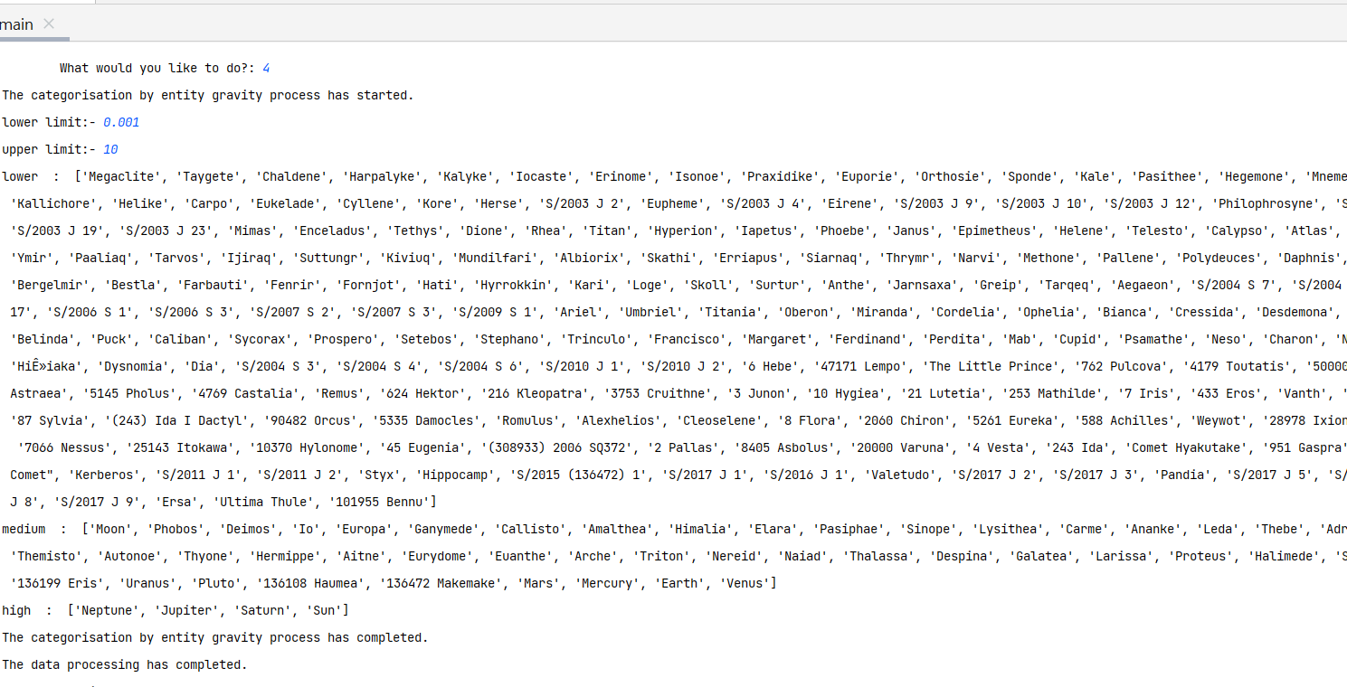

Slide 11
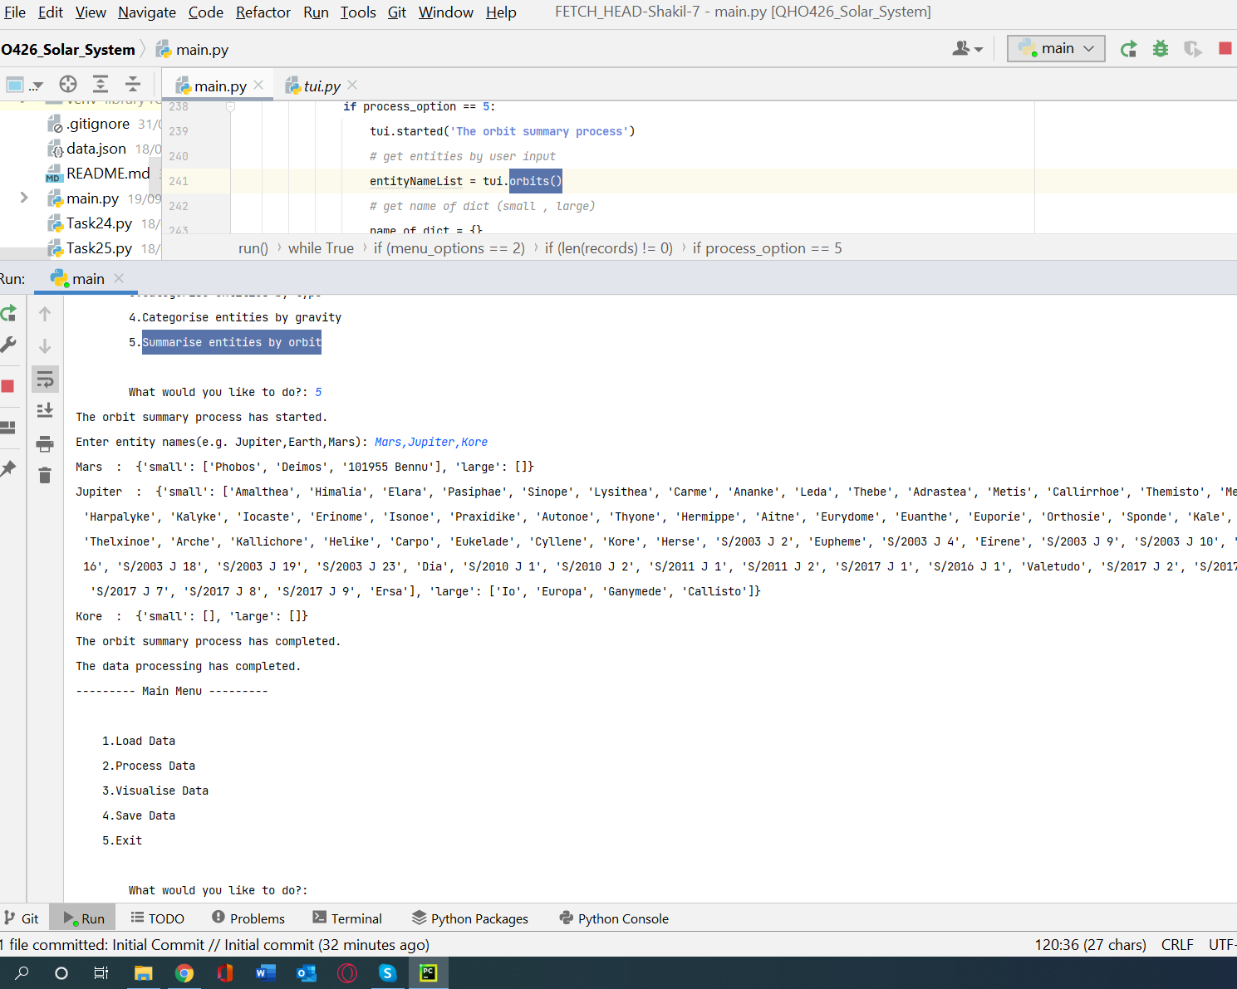
End of process Data

Slide 12
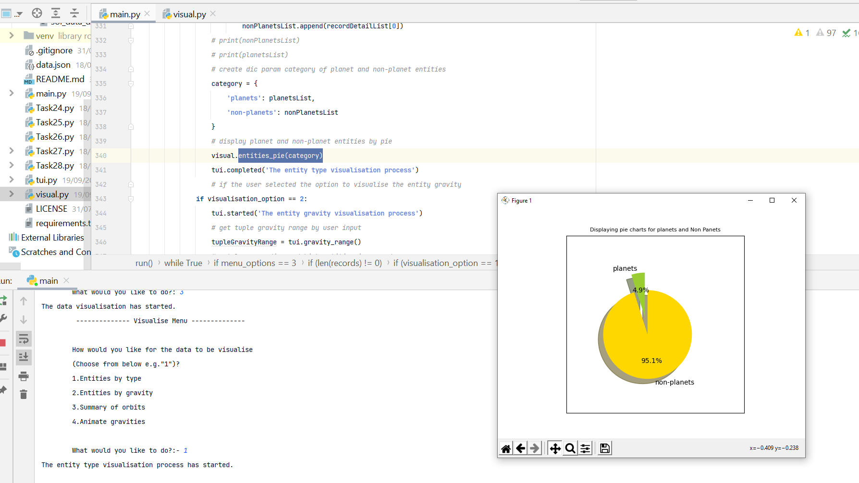
Data comes from CSV file

Slide 13
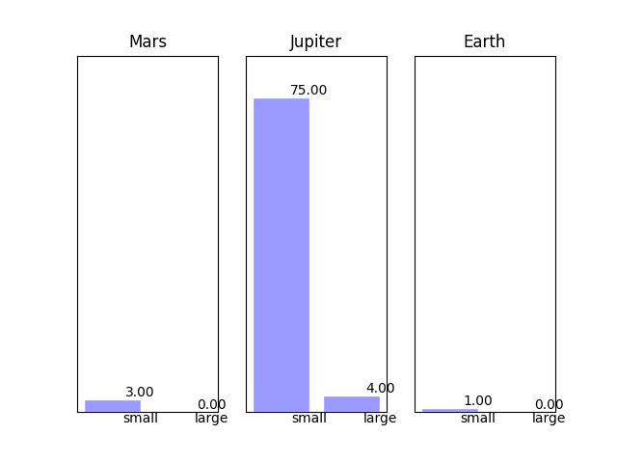
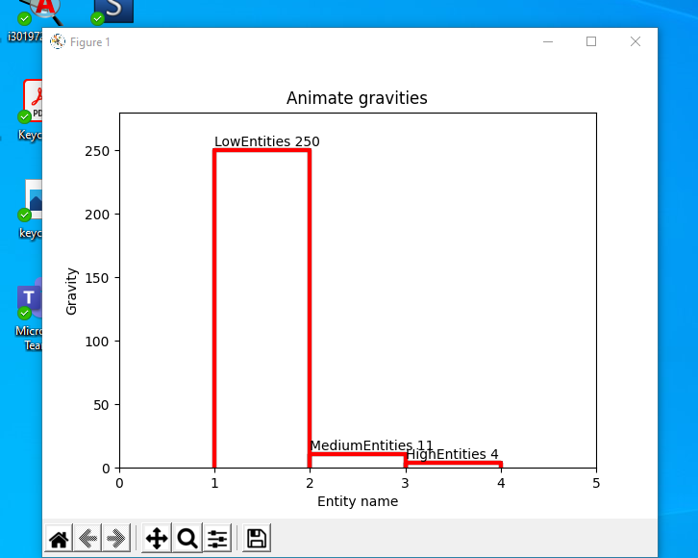
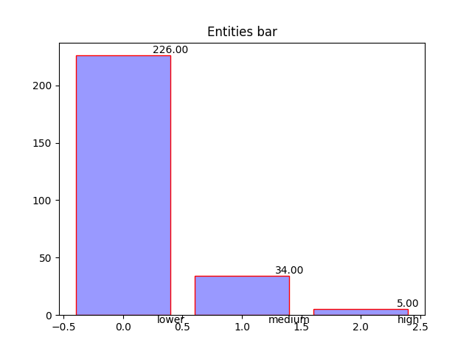
Summary of orbits
Animate gravities
Entities by gravity

Slide 14
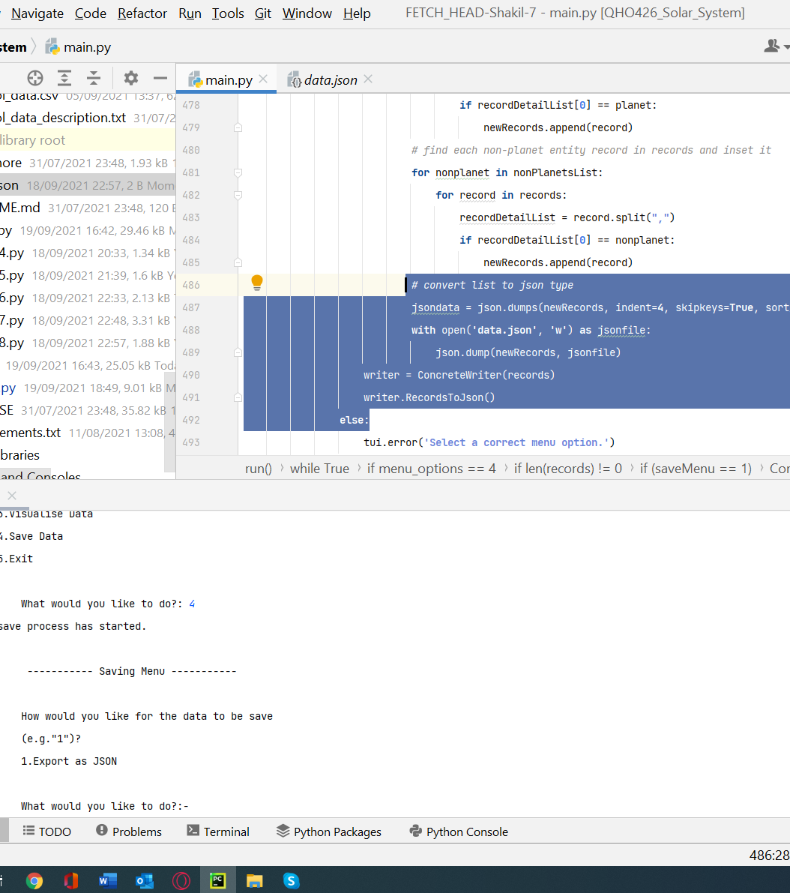
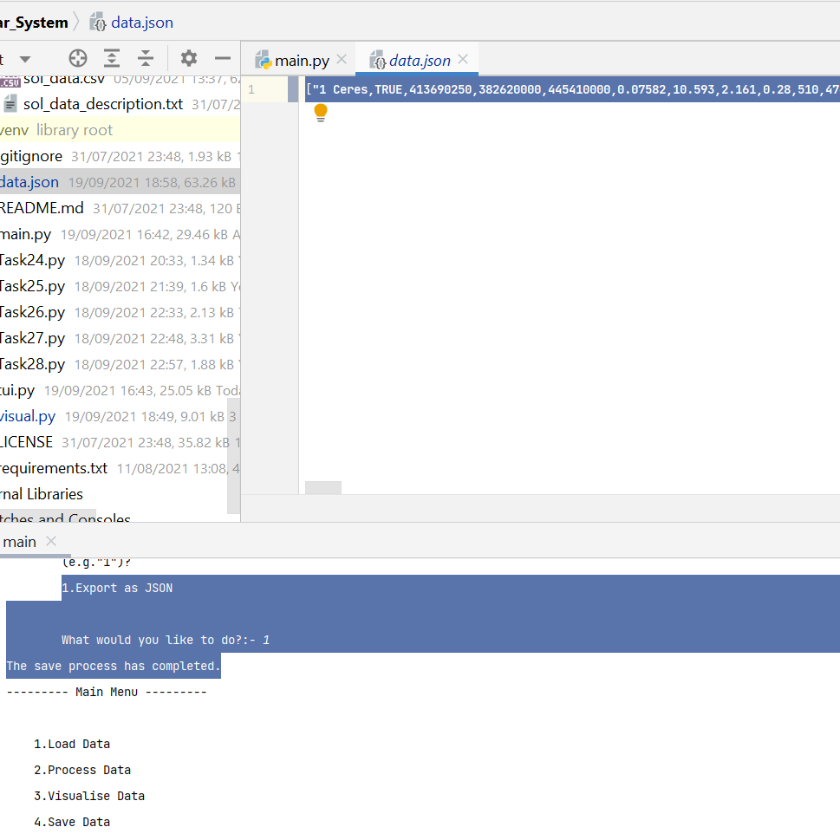
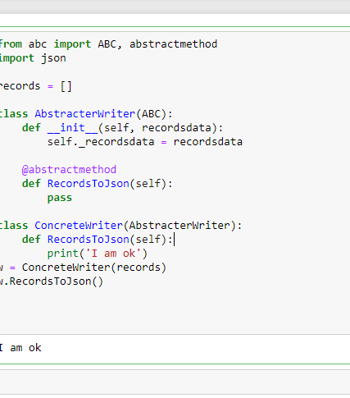

Slide 15
Conclusion
Finally solar system project successfully completed. At this stage I can now loaded CSV file data into a list to process and visualize and export data via json file format using OOP abstract method.

Slide 16
Thankyou !

